Slide 1
Optimization of ODE systems

Slide 2
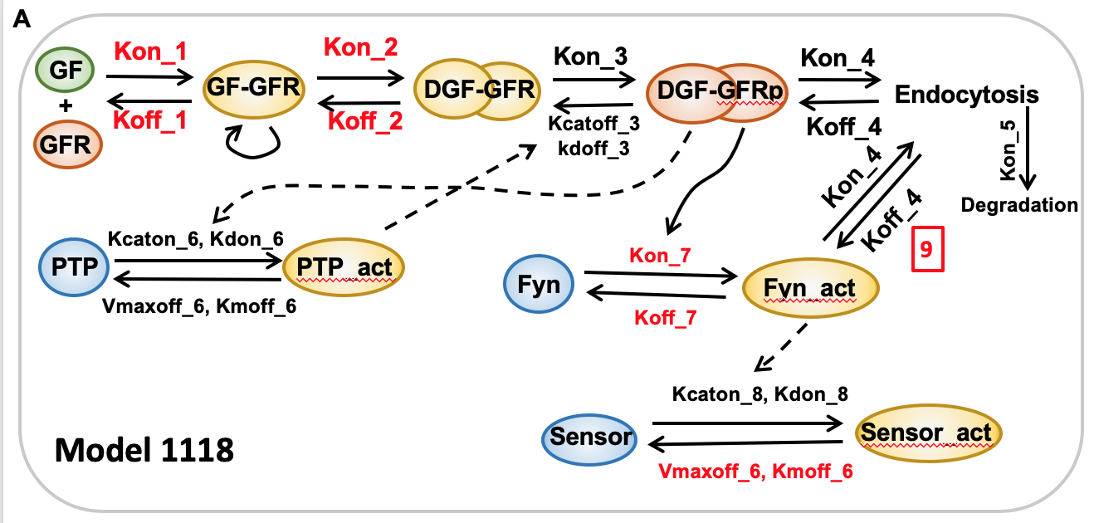
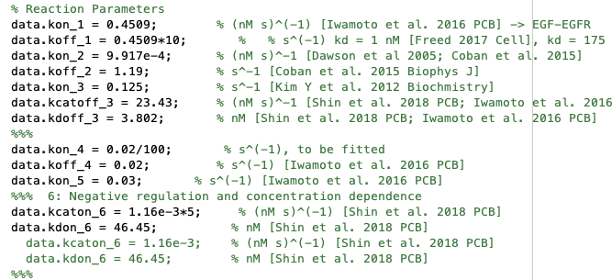
Model 1118
(1) Kcatoff_8, kdoff_8
(2) Kcatoff_3 , kdoff_3
Estimated biosensor activation is 9.142% out of 200 nM, which is about 18.28 nM.

Slide 3
Concentration dependence
Multiple output
Good concentration dependence, but sensor and active fyn has a big difference.

Slide 4
Optimized a good set of parameters for a single concentration
Step 1: error = 0.183
Step 2: error = 0.053
Step 5: error = 0.0013
Step 6: error = 0.00089

Slide 5
Optimized a good set of parameters for a single concentration
Step 6: error = 0.079
Fitting concentration dependence
Step 7: error = 0.055
Step 7: error = 0.039

Slide 6
Summarize the optimization process
Constraints on the parameter space are important. Currently we are using [0.01*a0, 10*a0], where a0 is the initial guess, a0 > 0.
It’s working , especially if we use a sequential stochastic process.
(3) Fitting concentration dependence is harder.
(4) It’s time consuming (5 min for each try), so a good computer really helps.
Next step
What kind of phenomena do we focus on optimizing?
Will test on the concentration dependence of EGFRs, receptor dimerization kinetics, and endocytosis kinetics.
Additional questions:
(1) Which biochemical parameters contribute to the difference in EGFR and PDGFR kinetics?
(2) What kind of distribution does the best parameters have?

Slide 7
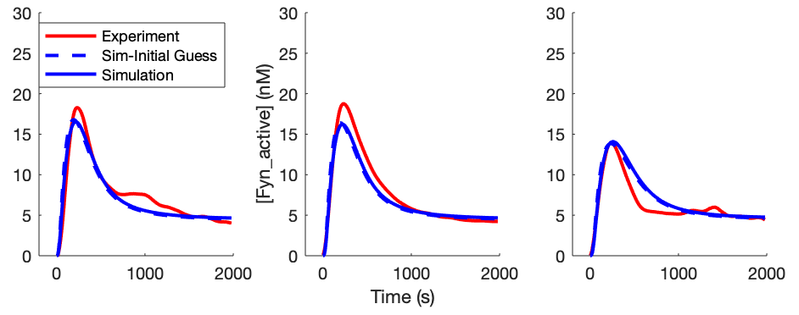
Monday 12/9/2019
Model_id = 12
[EGF] = 100 ng/ml 50 ng/ml 10 ng/ml
What parameters affect the stability of signal, or make the EGF more like PDGF signals?

Slide 8
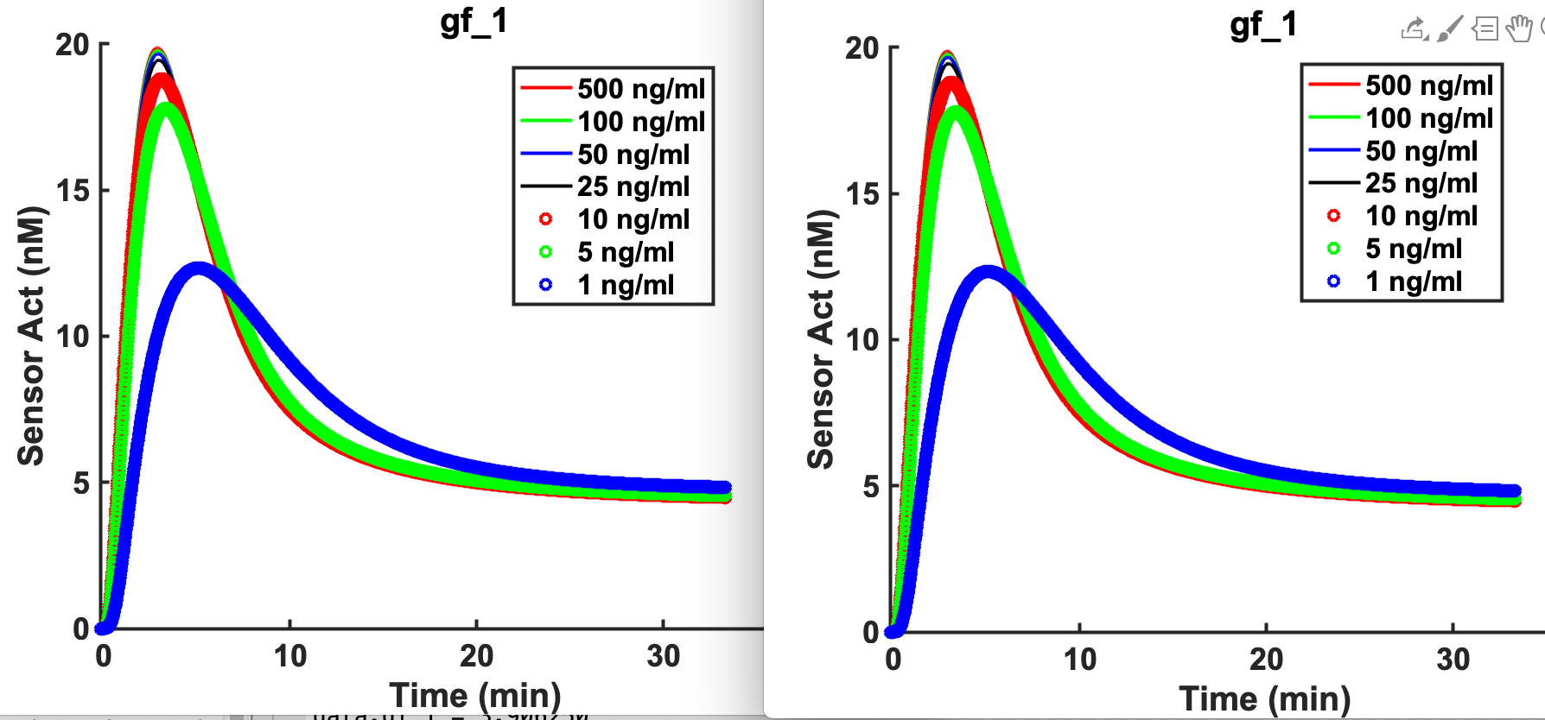
Probe parameters kon_2, koff_2, kon_4, koff_4, kon_7, koff_7
Control group
data.kon_2 = 0.155119 * 1e+01 data.koff_2 = 121.340124 * 1e-01

Slide 9
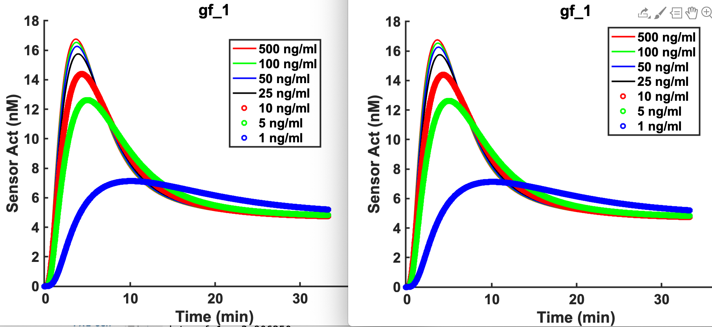
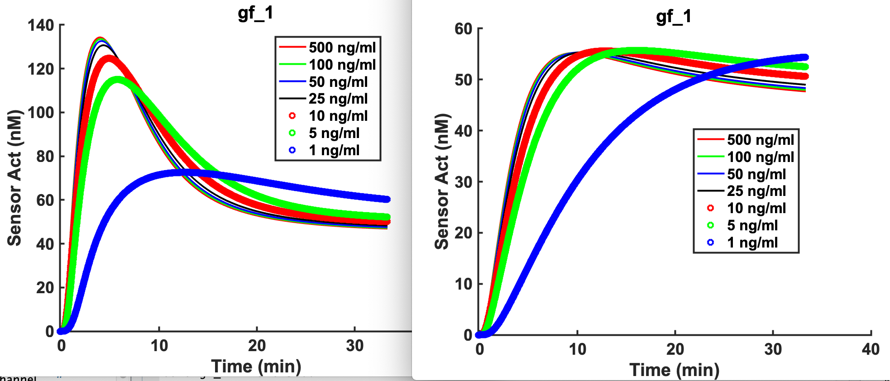
Probe parameters kon_2, koff_2, kon_4, koff_4, kon_7, koff_7
Control
data.kon_4 = 0.000238 * 1e-06 data.koff_4 = 8.082623 * 1e+06
data.kon_7 = 0.000511 * 10 data.koff_7 = 0.012233 * 0.1

Slide 10
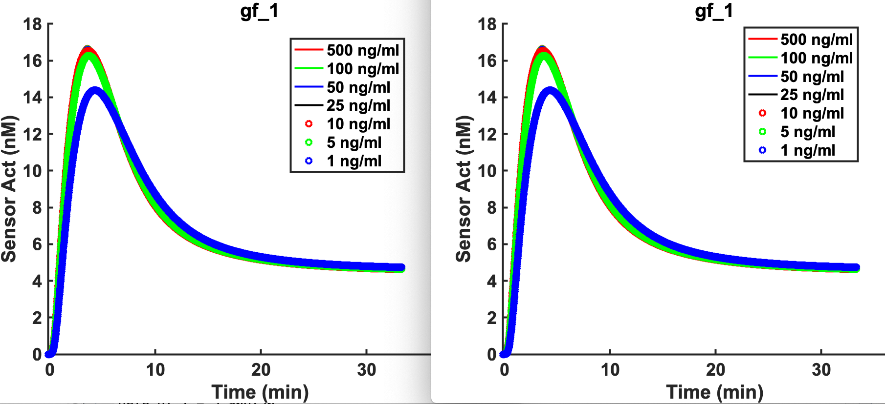
Probe parameters kon_1, koff_1, kon_3, kcatoff_3, kdoff_3
data.kon_1 data.kon_1 = 2.576373 * 1e+01. data.koff_1 = 2.855642 * 1e-01
Control

Slide 11
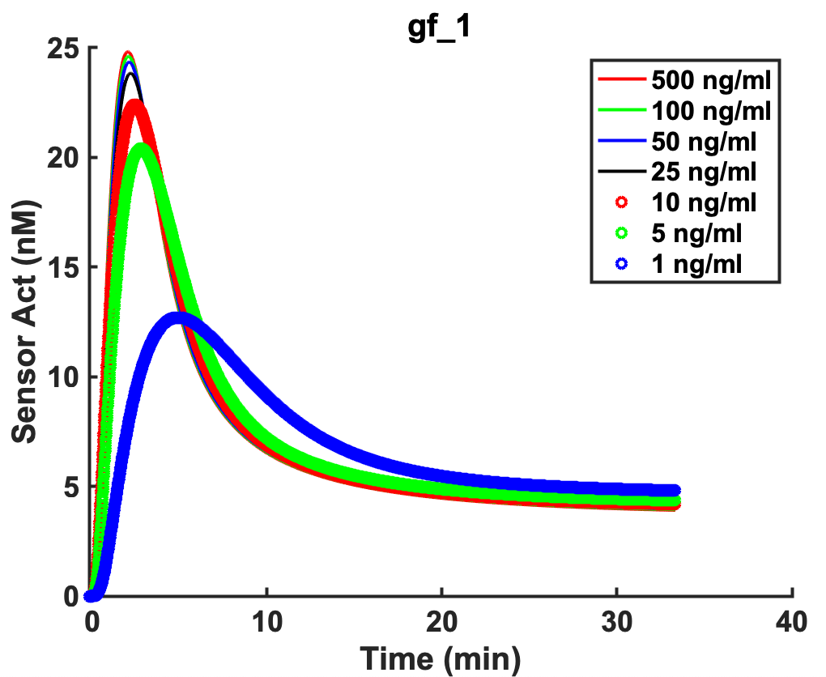
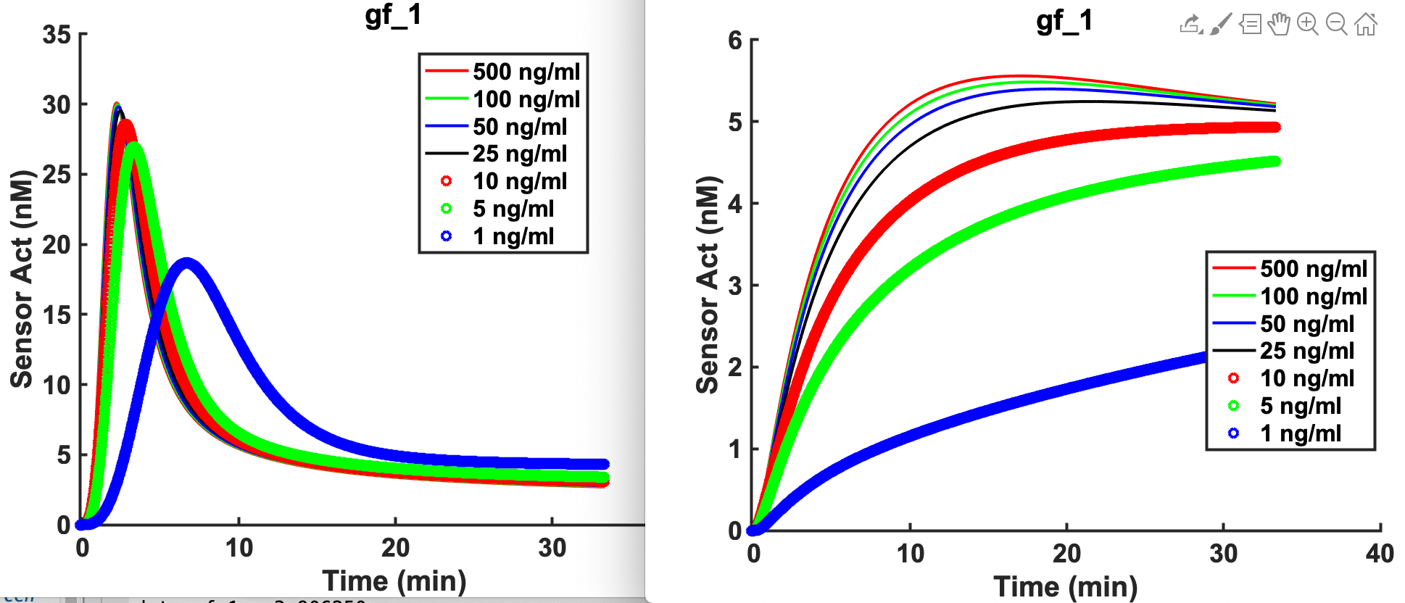
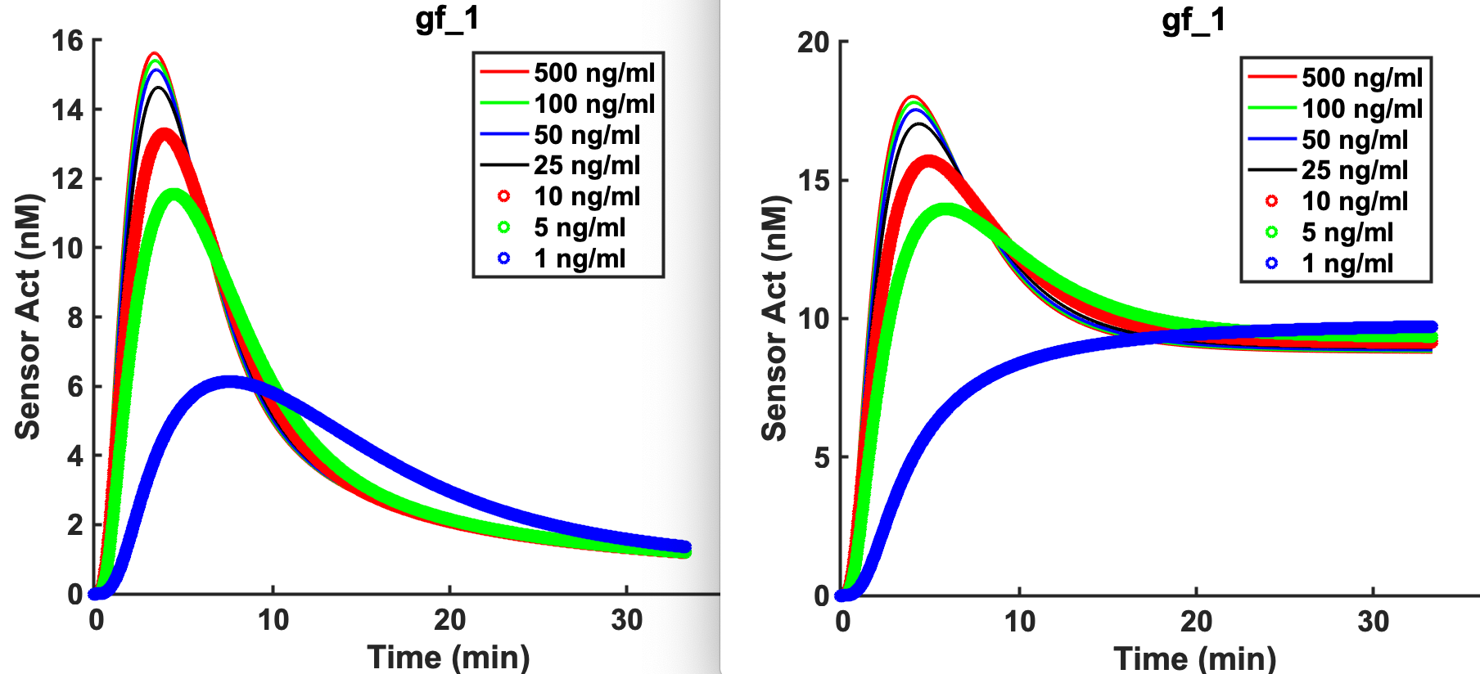
Probe parameters kon_1, koff_1, kon_3, kcatoff_3, kdoff_3
kon_3 = 0.003079 * 1e+01. kcatoff_3 = 46.720585 * 1e-02 kdoff_3 = 279.810135 * 1e-2
data.vmaxoff_6 = 0.040067 * 1e-02. data.kmoff_6 = 36.707622 * 0.5

Slide 12
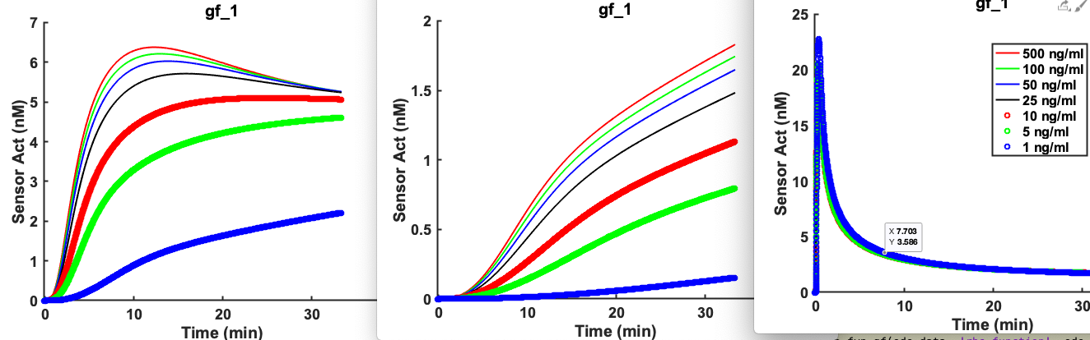
Further exploring koff_2 and egfr over expression.
koff_2 = 121.340124 * 1e+2. koff_2 = 121.340124 * 1e+04 gfr_total = 398.100000 * 1e+03
Conclusion:
As expected kon_7 and koff_7 (binding between active EGFR and Fyn) affects stability.
Unexpectedly, Kon_2 (growth factor head dimerization), kon_4, and koff_4 (endocytosis) are not affecting stability. The effect of koff_2 is opposite from expectation.
And more EGFR does not increase stability.
(2) and (3) indicate that the negative feedback signal from PTP is too strong.

Slide 13
Future work
Double check literature and reduce negative feedback from PTP.
Need to implement global optimization with multiple objectives
X Global optimization gives the same results.
Implement multiple objectives
Explore three-node networks with a negative feedback loop from PTP [ref: Gerardin J Lim WA 2019 Cell systems, The design principle of biochemical timers: circuits that discriminate between transient and sustained stimulation. Pdf available in emails.]

Slide 14
12/13/2019 Friday
Experiment
Model 1118 (ode_id = 2) Simulation
Need sometime to change model and test global optimization.
Model 1118 id12 Simulation
Model 1118 ode2 Simulation

